Slide 1

Chapter 1 - Introduction
Prepared by: Shier Nee, SAW
Based on: Probabilistic Machine Learning by Kevin Murphy

Slide 2
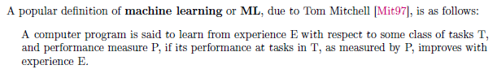
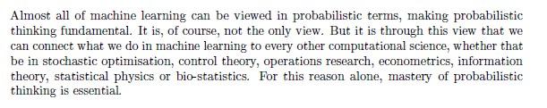
What is Machine Learning?
By Shakir Mohamed, research at Deep Mind.

Slide 3
AI Techniques
Supervised Learning
Reinforcement Learning
Unsupervised Learning
Labelled data with guidance
No labelled without guidance
Interacts with environment, decide action, learns by trial and error method
Notes:
Predictor/features/covariates
Label/target/response

Slide 4
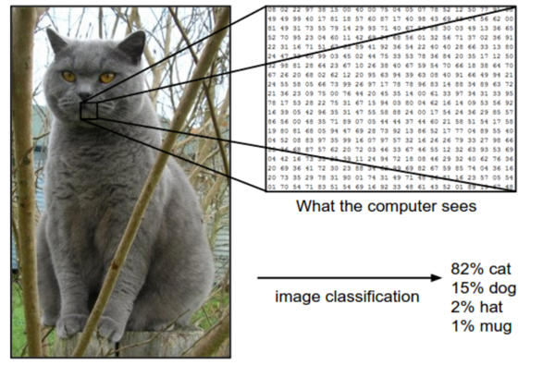
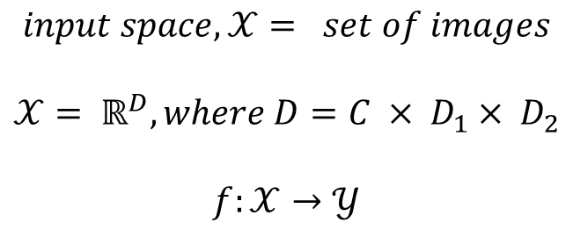
Supervised Learning - Classification
$$input space,𝒳= set of images$$
$$𝒳= ℝ^{D}, where D=C × D_{1}× D_{2}$$
$$f:𝒳→𝒴$$
Notes:
Image data

Slide 5
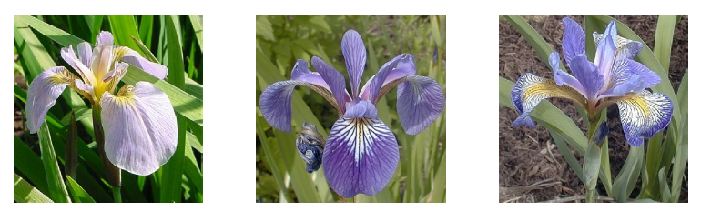
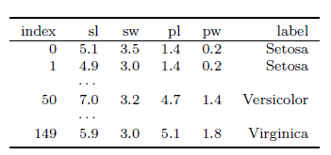
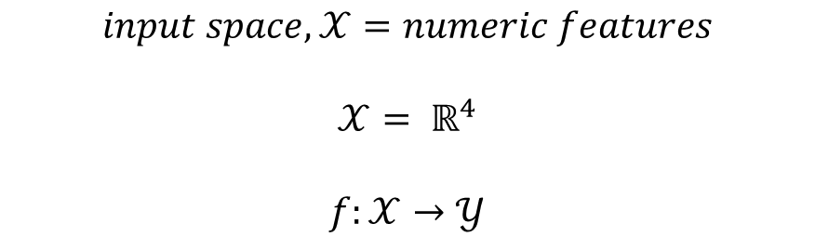
Supervised Learning - Classification
$$input space,𝒳=numeric features$$
$$𝒳= ℝ^{4}$$
$$f:𝒳→𝒴$$
Notes:
Tabular data

Slide 6
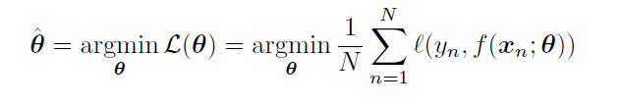
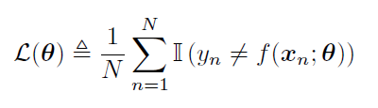
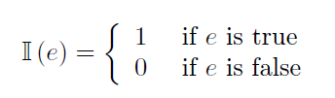
Empirical Risk Minimization
Supervised Learning - Classification
Notes:
Predictor/features/covariates
Label/target/response

Slide 7
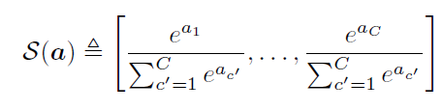
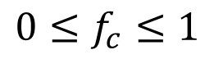
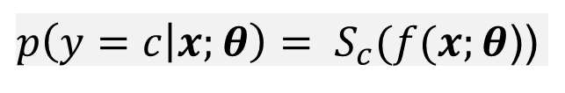
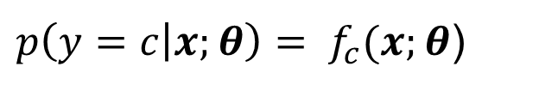
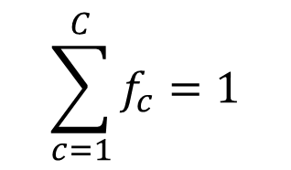
Supervised Learning - Classification
Supervised Learning - Classification
Supervised Learning - Classification
Uncertainty → using conditional probability distribution
$p\left(y=c | x;θ\right)= S_{c}(f(x;θ$))
$p\left(y=c | x;θ\right)= f_{c}(x;θ$)
Constraints:
Softmax function
$$0≤f_{c}≤1$$
$$\sum_{c=1}^{C}{f_{c}=1}$$
Notes:
Predictor/features/covariates
Label/target/response

Slide 8
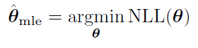
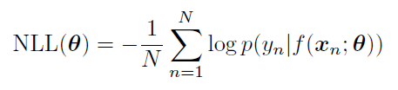
Supervised Learning - Classification
Maximum Likelihood Estimation
Minimizing Negative Log Likelihood
Notes:
When fitting probabilistic models, it is common to use the negative log probability as our loss function

Slide 9
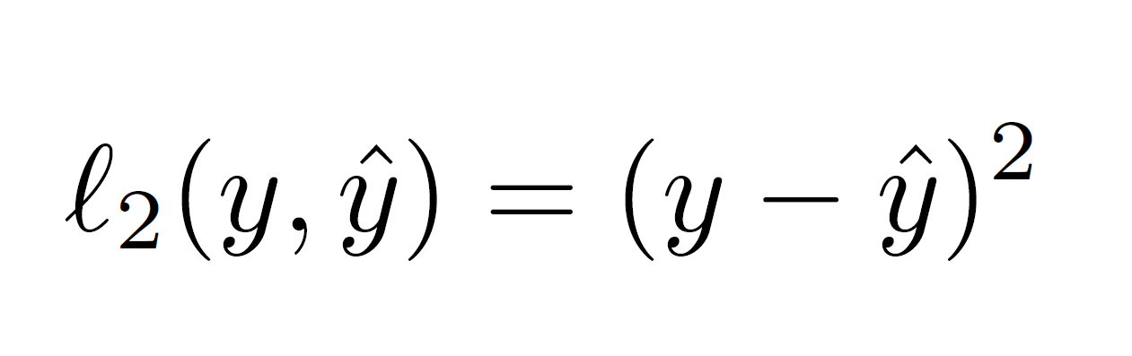
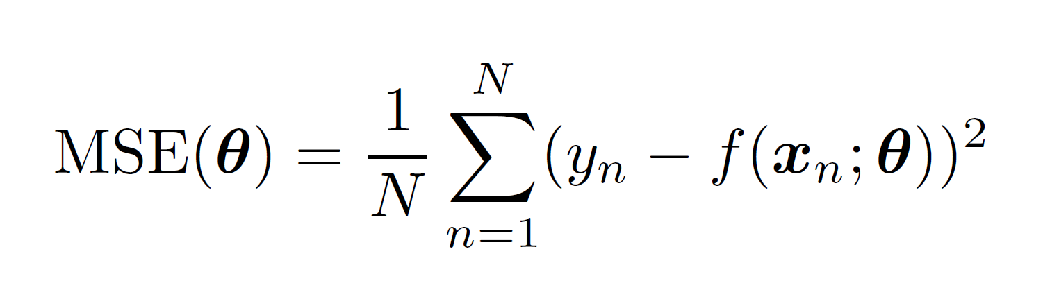
Output = Real-value → Quadratic loss
Supervised Learning - Regression
Notes:
When fitting probabilistic models, it is common to use the negative log probability as our loss function

Slide 10
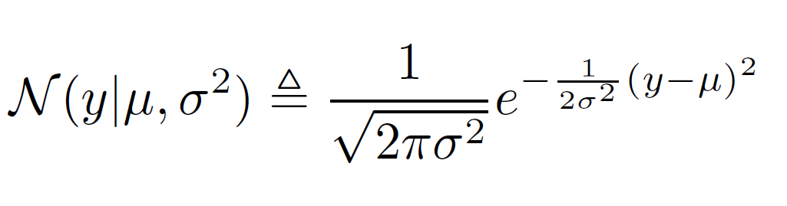
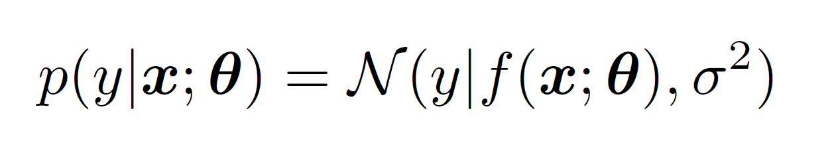
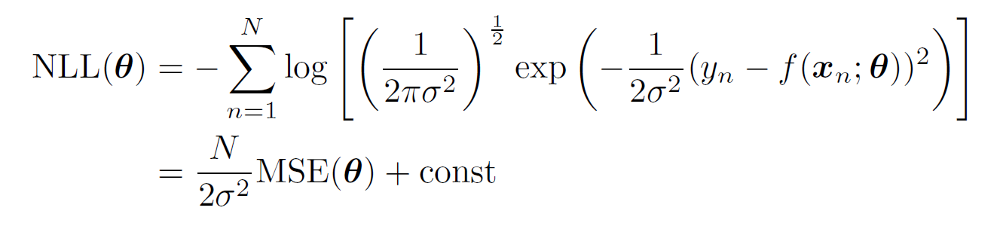
Supervised Learning - Regression
Uncertainty → Assume output distribution = Gaussian
Notes:
Predictor/features/covariates
Label/target/response

Slide 11
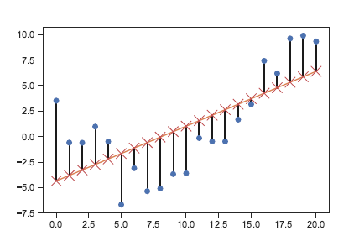
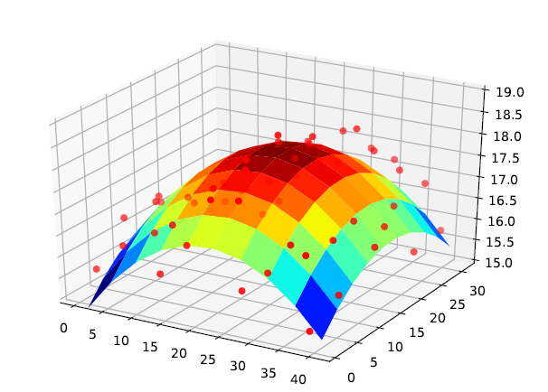
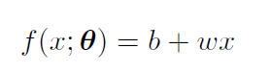
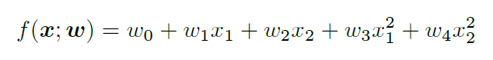
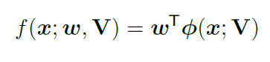
Supervised Learning - Regression
Linear Regression
Polynomial Regression
Deep Neural Network
1 Feature
Features Engineering
Feature Extraction Automatically
Notes:
When fitting probabilistic models, it is common to use the negative log probability as our loss function

Slide 12
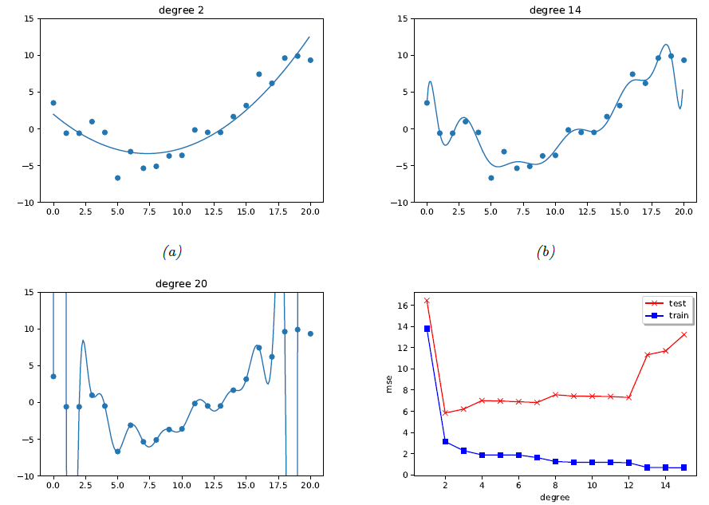
Generalization

Slide 13
Unsupervised Learning
Supervised Learning
Reinforcement Learning
Unsupervised Learning
Labelled data with guidance
No labelled without guidance
Interacts with environment, decide action, learns by trial and error method
Notes:
When fitting probabilistic models, it is common to use the negative log probability as our loss function

Slide 14
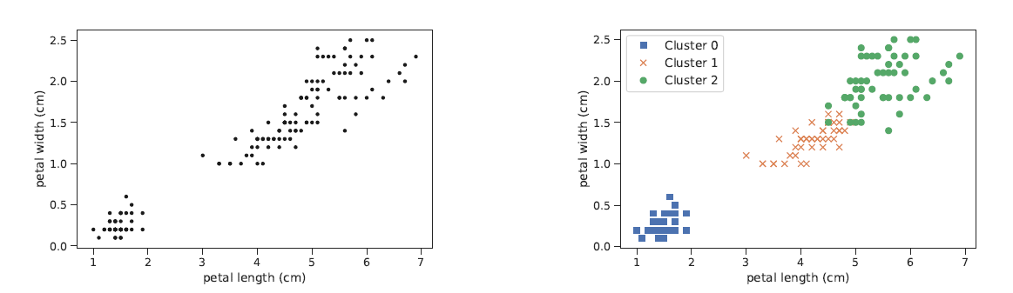
Unsupervised Learning - Clustering
Goal:
Partition the input into regions that contain “similar” points.
Notes:
When fitting probabilistic models, it is common to use the negative log probability as our loss function

Slide 15
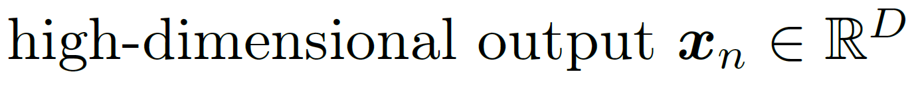
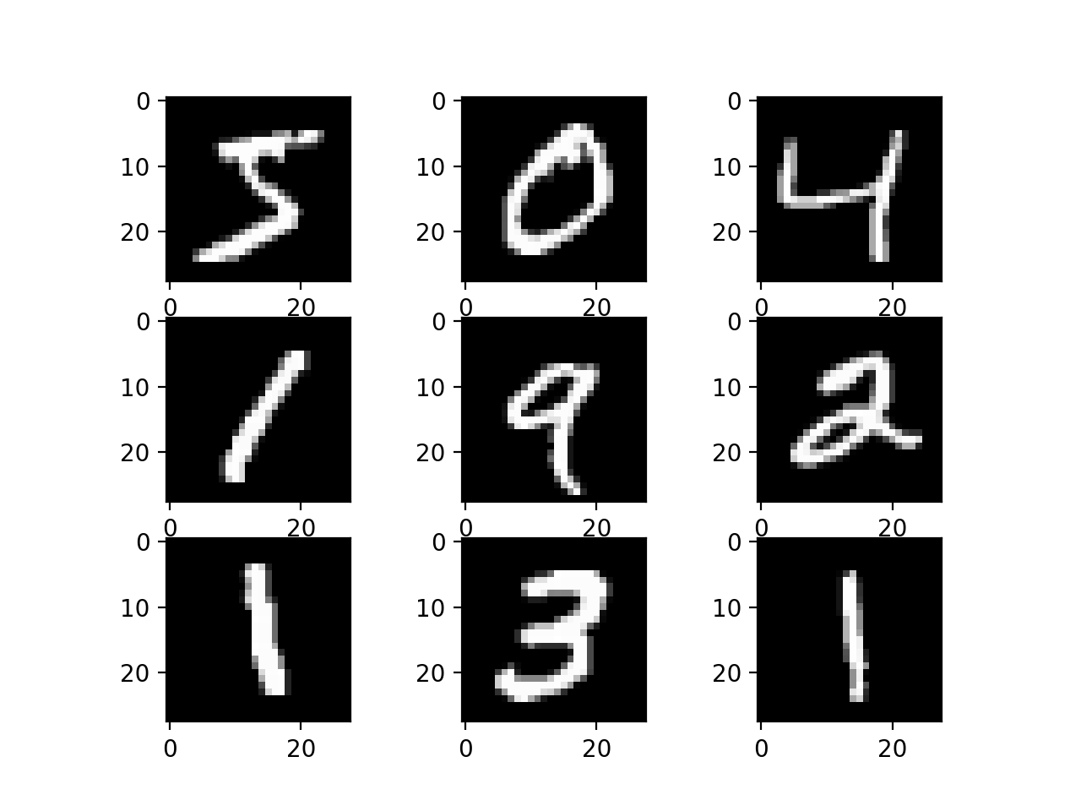
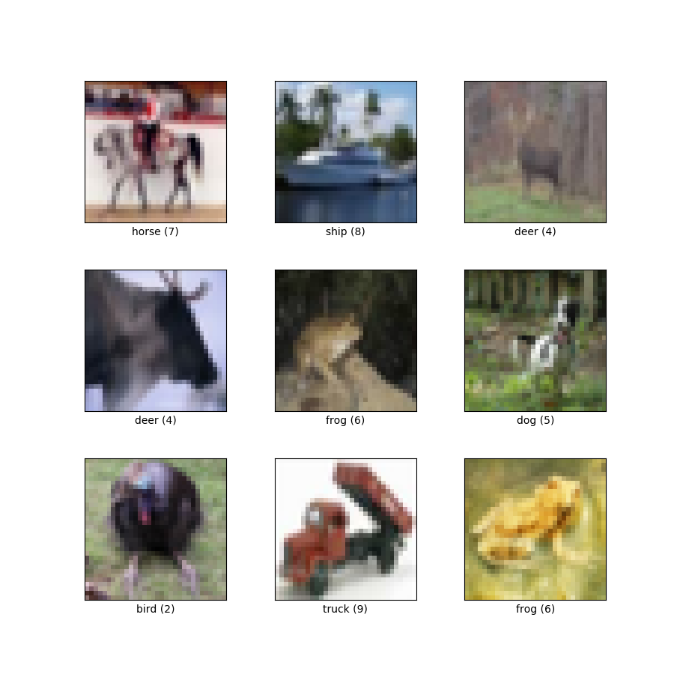
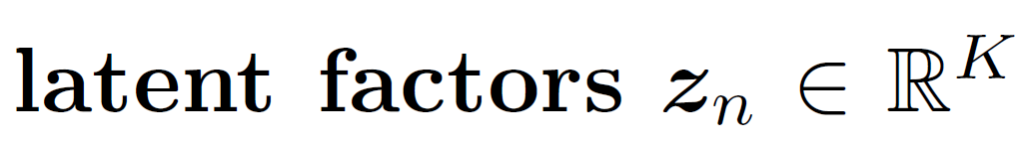
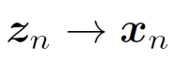
Unsupervised Learning - Clustering
Linear Model
Non-linear Model
Notes:
When fitting probabilistic models, it is common to use the negative log probability as our loss function

Slide 16
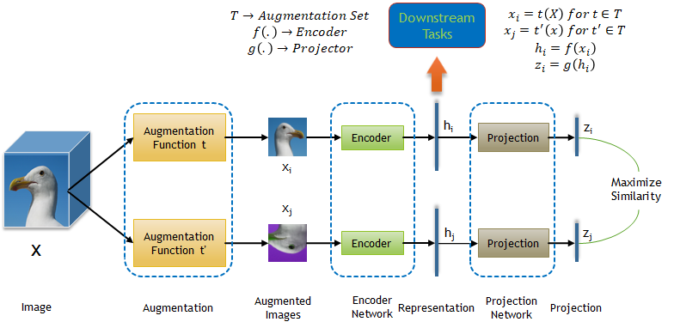
Unsupervised Learning –
Self-supervised Learning
From https://medium.com/analytics-vidhya/self-supervised-representation-learning-in-computer-vision-part-2-8254aaee937c
Notes:
When fitting probabilistic models, it is common to use the negative log probability as our loss function

Slide 17
Unsupervised Learning – Evaluation
It is difficult to evaluate since no ground truth.
Use learned unsupervised representation as features to a downstream supervised learning method
If unsupervised model learn useful features, the prediction in supervised model will increase.
Evaluate unsupervised model by reducing the number of labelled sample to get good performance.

Slide 18
Reinforcement Learning
Supervised Learning
Reinforcement Learning
Unsupervised Learning
Labelled data with guidance
No labelled without guidance
Interacts with environment, decide action, learns by trial and error method
Notes:
When fitting probabilistic models, it is common to use the negative log probability as our loss function

Slide 19
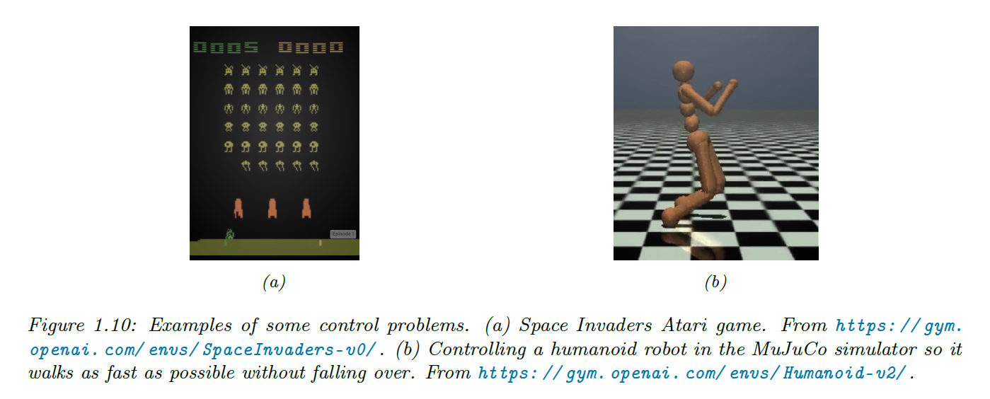
Reinforcement Learning
A system or agent has to learn how to interact with its environment.
This can be encoded by means of a policy a = (x), which specifies which action to take in response to each possible input x (derived from the environment state).
Notes:
When fitting probabilistic models, it is common to use the negative log probability as our loss function

Slide 20
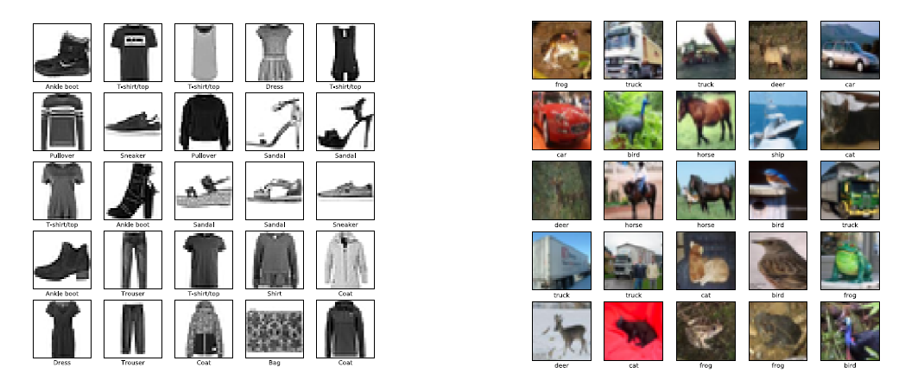

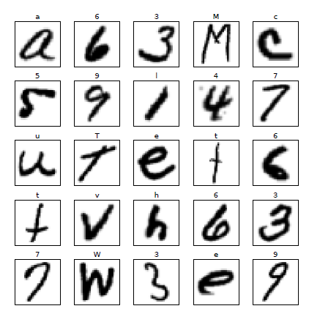
Common Small Image Datasets
MNIST
Fashion - MNIST
EMNIST
CIFAR
Notes:
MNIST – 60k data , 10 classes
EMNIST – 70k data, 62 classes
Fashion – mnist – 60k data, 10 classes
Cifar – 60k data, 10 or 100 classes

Slide 21

Common Large Image Datasets
ImageNet
This dataset spans 1000 object classes
1,281,167 training images,
50,000 validation images and
100,000 test images
https://www.image-net.org/download.php
Notes:
ImageNet – 14mil data – 20k classes

Slide 22
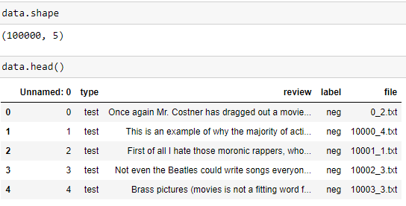
Natural Language Processing
IMDB movie review
Natural Language Processing (NLP)
Classification

Slide 23
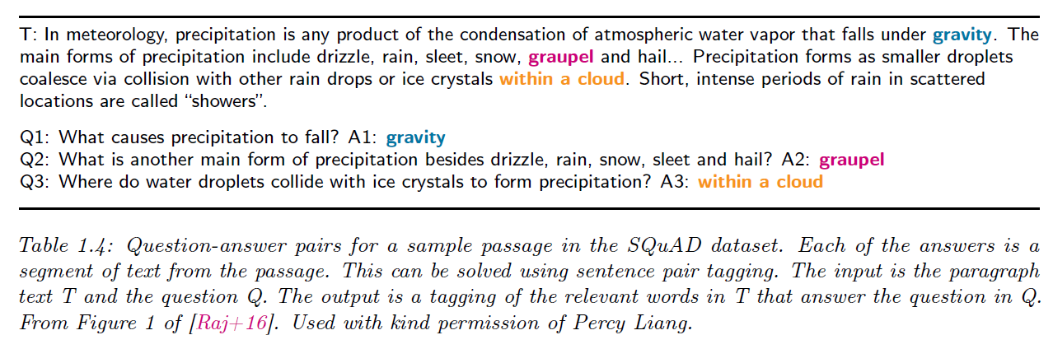
Natural Language Processing
Natural Language Processing (NLP)
Translation
Canadian parliament (English-French pairs)
the European Union (Europarl).
Document summarization, Question answering

Slide 24
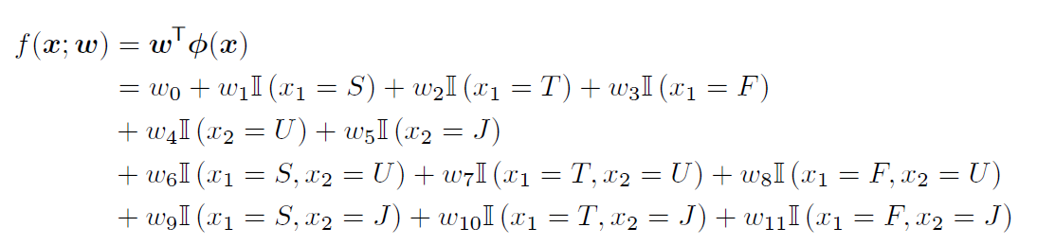
Discrete Input Data
One hot encoding
3 colors (say red, green and blue)
one-hot(red) = [1; 0; 0],
one-hot(green) = [0; 1; 0],
one-hot(blue) = [0; 0; 1].
Feature Interaction

Slide 25
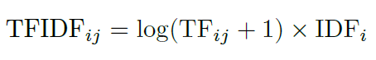
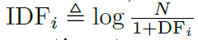
Text Data
Bag of words
dropping punctuation,
converting all words to lower case;
dropping common but uninformative words – “and”, “the” (stop word removal_
Replace word with their base form – “running”, “runs” → “run” (word stemming)
TF-IDF: Term Frequency — Inverse Document Frequency
DFi is the number of documents with term i
https://towardsdatascience.com/tf-idf-for-document-ranking-from-scratch-in-python-on-real-world-dataset-796d339a4089

